Slide 1




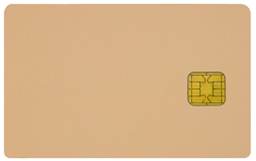
IBM : What does Day 1 look like for End Users?
PRSI John Miller
No changes:
Computer
Logon process
Access current server applications
Printers, phone
Changes:
IBM “Software” to access CVX apps: via “Virtual GIL”
Asia software enables this
Tcard / PIN for logon
CVX Email; phaseout legacy Lotus Notes Email
CVX apps: SAP, Intranet “web”
CVX Transition Team
No changes:
GIL Notebook 91324343
WiFi or wired access to IBM (as if at home or a hotel)
VPN “Pulse Secure” to tunnel via Internet back to CVX LAN
No access to legacy IBM apps
PRSI / BRES will setup Transition Team office space (this is where Internet access will be enabled)
John.Miller@gmail.com
Note: We should try to limit the number of “new” PRSI users provisioned after Day 1. Connections from CVX users on CVX LAN to PRSI will be enabled during the TSA.

